Slide 1
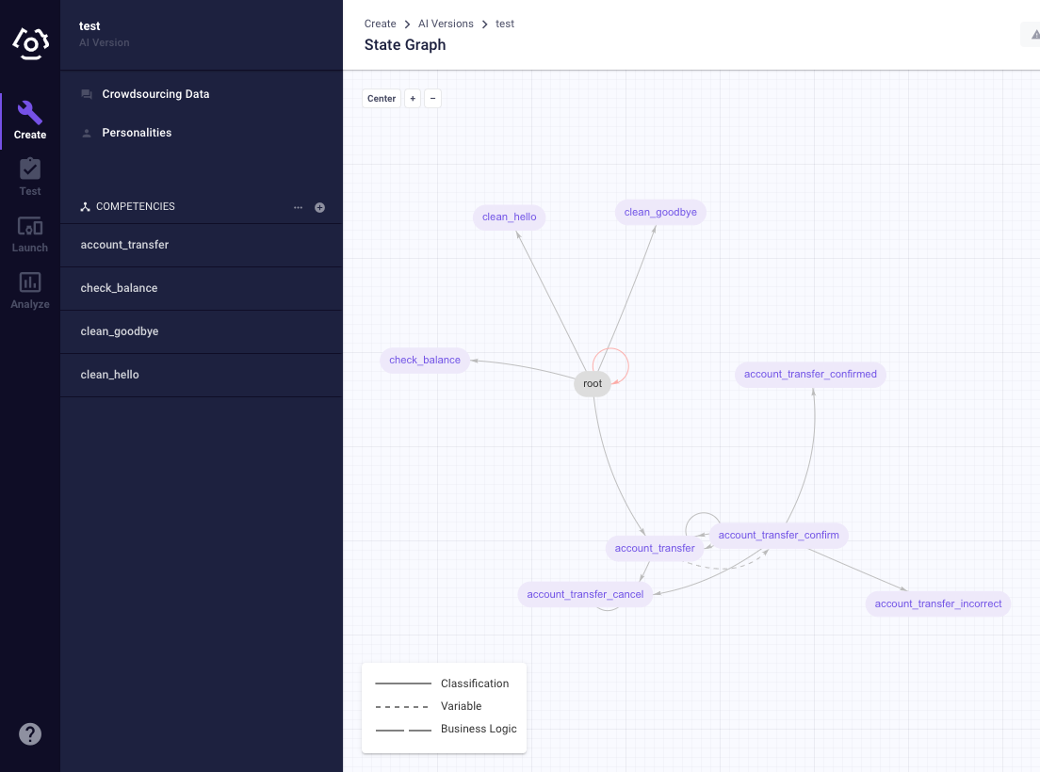
Clinc Platform
Developer Experience
UX research report
Yi-Chun Chen
Sean Stapleton

Slide 2
Research questions
Methodology
What are the major archetypes of Clinc platform users?
How do they use the platform?
What are the user pain points?
How might we address them?
6 * V75 partners
4 * AIXD members
Contextual inquiry (interview protocol for V75) (Interview protocol for AIXD)
Affinity diagramming from interview notes
Overview
Data collection
Deliverables
Recording
Audio / video recording
Notes taking during the interviews
V75 data location: here.
AIXD team data location: here.
A set of user personas
Key findings from the affinity wall and suggestions
A set of workflow diagrams

Slide 3
Key findings from affinity diagramming
Notes:
https://docs.google.com/document/d/1cZK2y1nizFraFUD6XjKLCNuP8glzRRCyjnSncLtIdg8/edit?usp=sharing

Slide 4
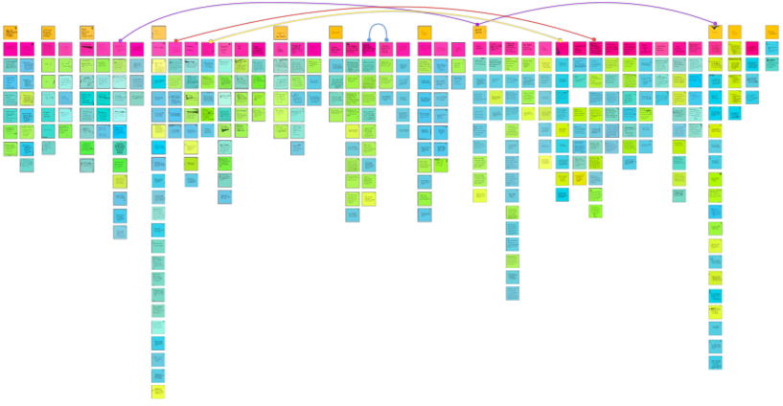
Category (e.g., testing)
Related Insights
Insights (e.g., testing is time-consuming)
Notes/quotes (e.g., “Testing is my least favorite task -- it should have been so simple.”)
Download PDF

Slide 5
“We need to formalize a standard for project scope.”
“It’s difficult to define when something is ready to ship.”
Pre-creation workflows are poorly defined and lead to frustration later in development
The current scoping process is difficult to act on developers feel they would greatly benefit from end user utterances
Developers have unclear definitions of success (self-evaluation, customer satisfaction, “Clinc Quality”)
Notes:
https://docs.google.com/spreadsheets/d/1lqslAyqfbFQQ5G63B5B7eM9AshJ3G-3cyv_AZW4Rhvo/edit?usp=sharing

Slide 6
“It’s faster to create a new model than refactor an old one.”
“It’s frustrating not knowing if slot labels are correct.”
“Creating a test suite is my least favorite task -- it should have been so simple but it’s so time-consuming.”
2. Poor information architecture, lack of bulk data features, and synchronous development prevents user from building quickly
Information accessibility on the platform is low; developers rely on recall rather than recognition in several tasks
Moving data around is difficult (exporting data, splitting competencies, labelling clf datasets)
The testing process is time consuming; High latency to create, and difficult to organize, find, and update tests
Developers are frustrated by they can’t work at the same time and are required to think deeply about overlapping work
Full list of pain points

Slide 7
“I have no good feel for where the model does and doesn’t perform well”
“Seeing the distribution of slot values is not actionable”
“It’s not fun to just see a bunch of numbers”
3.
Information is not always visible for users to make informed decisions
Data insights are not actionable, making it difficult to triage issues
Customers keep adding data and creates more issues when trying to solve one
It is difficult to compare multiple competencies (most common behavior)
Uses pen & paper to track word frequencies across states

Slide 8
“Sometimes I crowdsource 200 and only get 10 good ones.”
4.
Crowdsourcing takes a lot of time and does not generate much useful data
Even when users make explicit descriptions, the results aren’t always good.
Notes:
https://docs.google.com/document/d/1cZK2y1nizFraFUD6XjKLCNuP8glzRRCyjnSncLtIdg8/edit?usp=sharing

Slide 9
Personas

Slide 10
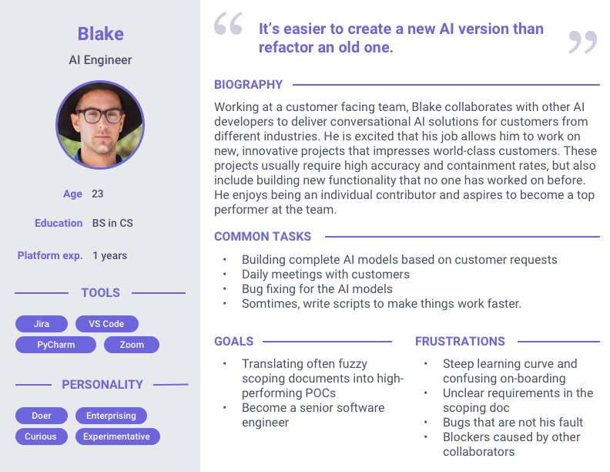

Slide 11
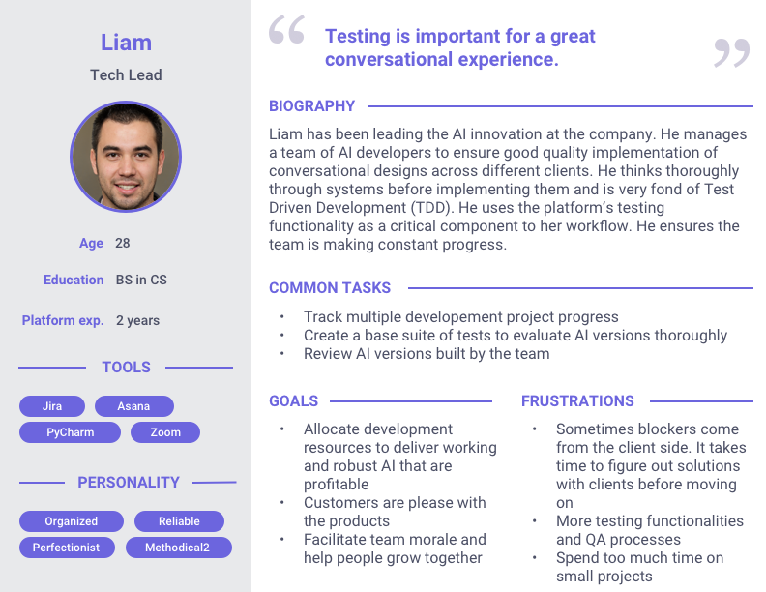
Notes:
Tester - (v)
Ai:
Conversational designer - no tech bg (v)
Engineer - has tech bg
Enigneer manager / tech lead

Slide 12
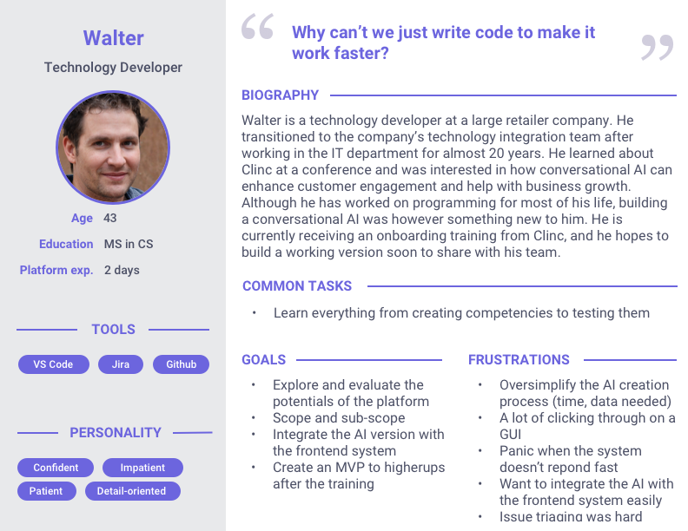
Notes:
Tester - (v)
Ai:
Conversational designer - no tech bg (v)
Engineer - has tech bg
Enigneer manager / tech lead

Slide 13
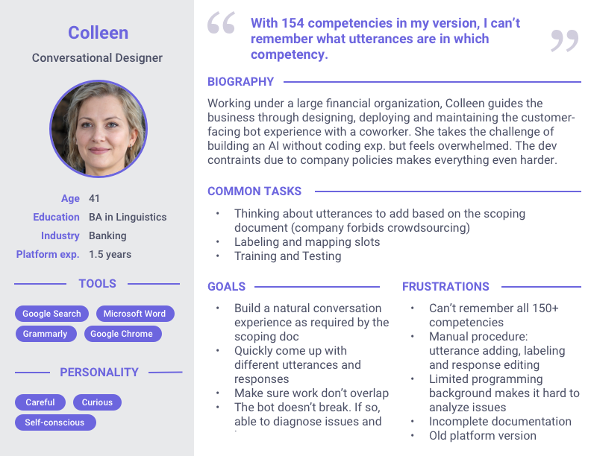
Notes:
Tester - (v)
Ai:
Conversational designer - no tech bg (v)
Engineer - has tech bg
Enigneer manager / tech lead

Slide 14
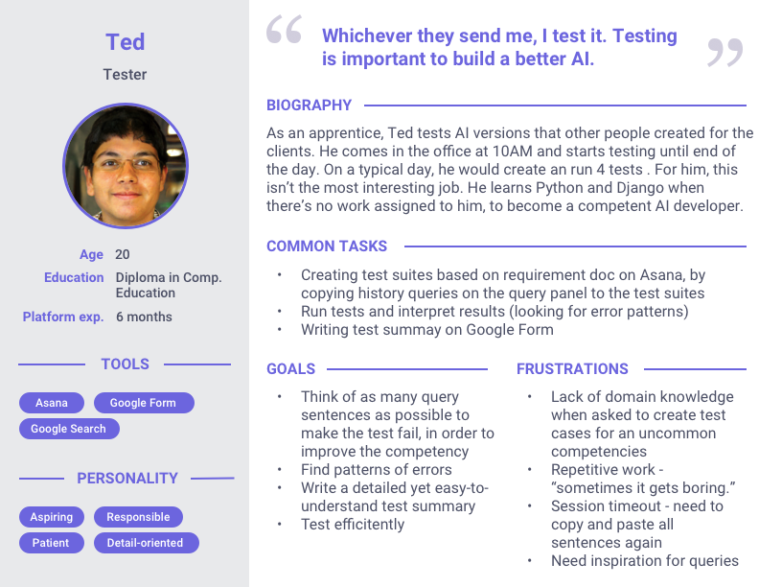
Notes:
Tester - (v)
Ai:
Conversational designer - no tech bg (v)
Engineer - has tech bg
Enigneer manager / tech lead

Slide 16
Workflows

Slide 17
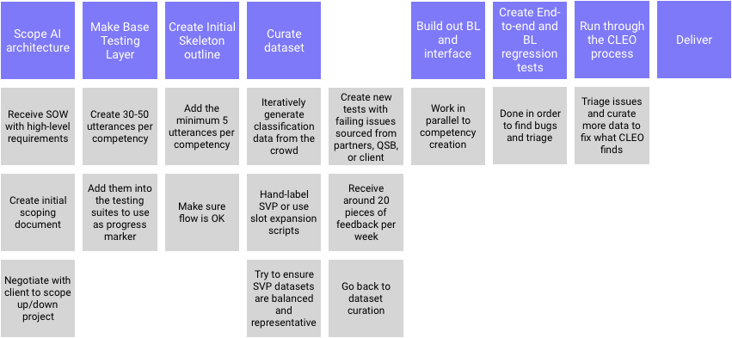
AIXD

Slide 18
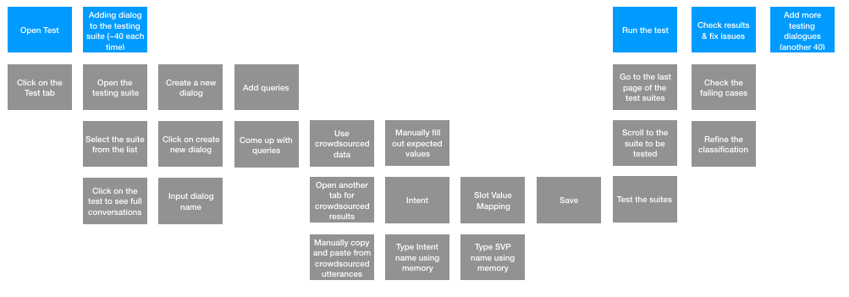
Testing at V75
The platform
Other workflows at V75

Slide 19
Testing a competency
Low work efficiency. Would a search bar help?
Manual work would likely incur errors. Explore export/import functionality?
Likely to cause error. Provide list view for user selection?

Slide 20
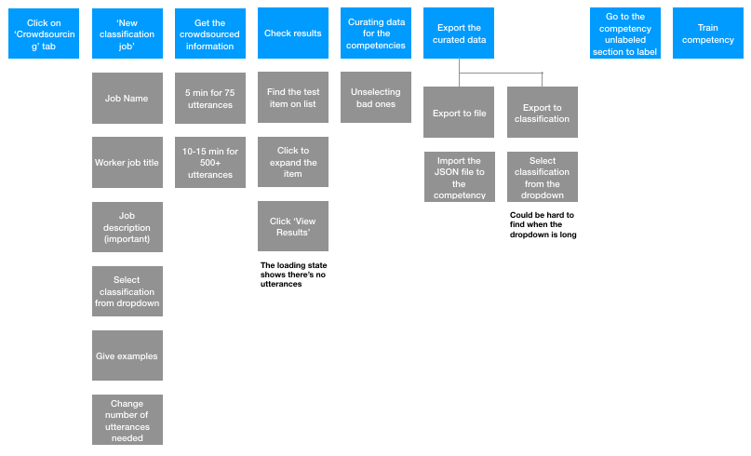
Crowdsourcing

Slide 21
Pre-creation
2. AI building
Develop a standardized scoping process
A scoping doc generator?
Users have a way to validate the progress of the AI version
Pre-created validation set that shouldn’t be added to the utterances
Crowdsource a validation set
Streamline the workflow
Optimize importing dialogues from the query side bar
Allow for shortcuts
Optimize bulk data management
Provide more support for collaboration
Collaboration status and notifications
Remove UI blockers
Solution proposal
3. Insights and health
4. Crowdsourcing
Users can see an overview of AI health
Overview of a competency and cross-reference different competencies (e.g., utterances, intents, etc.)
Explore ways to optimize crowdsourcing

Slide 22
Deal with the untouched
Make use of the results
UX research never ends.
Continue iterating the personas and workflows from the current version.
Access to external customers (to better understand Walter) & quantitative data (survey)
Everyone on the platform team should be engaged with the users.
Empathy, brainstorming, design, and heuristic evaluation workshop series in the platform team/other teams.
Next steps
Usability evaluation
Measurable metrics
(Bi-)weekly guerilla testing with ongoing versions
Longitudinal study with newly launched features (response editor / slot mapping)
Hope results can be shared in person within the team
Identify key metrics to measure success of the platform

